Slide 1
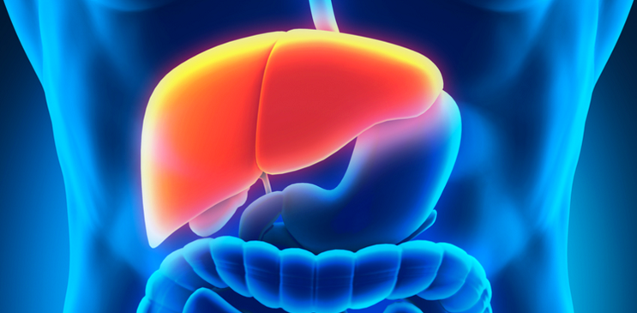
LIVER CANCER

Slide 2
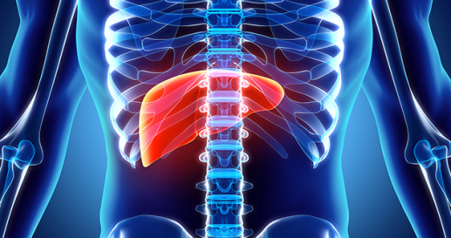
What is liver cancer?
Generally cancer are cells in the body that grow out control
The cells that grow out control outgrow the normal cells.
These might even start spreading to other areas of the body.
Liver cancer are the cells in the liver that grow out of control
Notes:
Generally cancer are the cells within the body that grows out of control or even grow in an abnormal way and can spread to others part of the body
When it comes to liver cancer, these are the cells that begin out of control within the liver(Kuang, 2018)

Slide 3
What is liver cancer cont..
Primary liver cancer are the cells that begin to grow out of control within the liver
Liver cancer can even be spreading from other body organs
Secondary liver cancer develops when the cancer cells are spreading from other body organs
The cells basically travel from other areas of the body through blood stream
Notes:
Primary liver cancer are the cancerous cells that start within the liver organs and affect the ability of the liver to function(Smith, 2016)
Secondary liver cancer are the cancerous cells that spread to liver from other body organs
These cells are collected by the liver from other organs through the blood stream and eventually begin to grow from liver.

Slide 4

Importance of liver cancer to men’s health
Fundamentally, males and females respond to chronic liver diseases differently
In regards to liver cancer in male, they are more prone to cancer liver than female
This explains why liver cancer topic is important to male’s health.
In addition men develop liver cancer at twice rate of women
Notes:
Fundamentally, males and females respond to chronic liver diseases differently making it important for everyone to understand especially for the male(Roblin, 2014)
The males are more prone liver cancer and they are likely to develop liver cancer at twice rate of women globally

Slide 5
Liver cancer prevalence
Globally, liver cancer is the second leading cause of death
It is more observable among the male with its incidences occurring between age group 45 to 60 years
Study indicates that primary liver cancer is diverse in different countries
85% of primary liver cancer incidence happens in developing countries
Notes:
Globally, liver cancer is the second leading cause of death and it is largely observed among the males who are aged between the age of 45 and 60 years of age(Thomas, 2015)
Study has shown that primary liver cancer is more likely to occur in the developing countries of Eastern Asia, Southern Asia, Northern Africa and even Southern part of Africa.

Slide 6
Cancer prevalence cont..
Within United States, men are 3 times more likely to be diagnosed with liver cancer than the female
It is estimated that deaths from liver cancer are 30,220 men while female is 9,660 annually
Out of 100% of individual diagnosed with liver cancer only 18% survive within US
43% survive liver cancer when diagnosed at early stage before it spreads to other body parts
Notes:
Within US men are 3 times likely to be diagnosed with liver cancer than the female counterparts(Roblin, 2014)
The death is also higher within the male being estimated at 30,220 while the female counterparts the death is estimated at 9,660 which is lower than the male
Among the people diagnosed with liver cancer, 18% of them only survive within United States.
In addition, when liver cancer is diagnosed at early stage 43% survive it since treatment is available.

Slide 7
Costs & Consequences of liver cancer
In general, liver cancer has a high mortality rate around the globe
Within US alone, 30,200 deaths are reported as a result of liver cancer.
Globally, 85% of liver cancer incidences do not survive especially the developing countries
In regards to financial cost, liver cancer is costly to treat
Notes:
Death rate due to liver cancer is high around the globe with US alone reporting a total of 30,200 yearly.
Globally, 85% of liver cancer patients do not survive making it the second high cause of deaths.
Treating liver cancer is costly and requires modern technology and also the best medication if a patient has to survive.

Slide 8
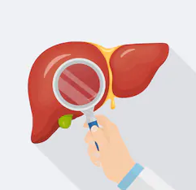
Liver cancer treatment/intervention
When diagnosed with liver cancer, the doctor use practical system to determine treatment options
The doctors categorizes liver cancer into
i.) potentially or transplantable
ii.)Unrespectable
iii.)Inoperable
iv.) Advanced
Notes:
Immediately after the doctor diagnises a patient with a liver cancer, he/she determines the treatment option depending on a number of categories or the stage.
Some of the categories of liver include potentially or transplantable, unrespactable, inoperable and the advanced category

Slide 9

Liver cancer treatment/intervention cont..
Different stage of liver cancer can be treated by different type of doctors.
These are the different types of doctors who can treat liver cancer
Surgeon-treats liver cancer with surgery
Radio oncologist treats cancer with radiation therapy
Medical oncologist treats cancer with chemotherapy
Notes:
Cancer treatment and intervention varies with the stage at which it was diagnosed(Bosch, 2017).
However, there are three types of cancer treatment and all three of them also depends on the stage of the cancer.
In additional to doctors who treat cancer, many other specialists are involved in cancer treatment and the may include nurses, psychologists and social workers.

Slide 10
Liver cancer prevention
In a bid to prevent against cancer, children are given a vaccination for hepatitis B.
This makes the adults at a high risk for cancer infection since they cannot be vaccinated
Some of the measures against cancer infection include limiting alcohol and tobacco use
Observing healthy diet and avoiding food that can make you obese
Notes:
Cancer prevention starts with vaccinating children against hepatitis B which is recommended by WHO world wide(Daniell, 2015)
Among the adults the prevention can be done through taking measures that will help them avoid infection of the cancer.
The first step is limiting the usage of alcohol and tobacco use.
Another way to prevent against liver cancer is observing heathy diet as well as avoid food that causes obese.

Slide 11

Liver cancer prevention cont..
Another way of prevention against liver cancer is limiting the exposure to cancer causing chemicals
It is also important to treat diseases that increase liver cancer risk.
Liver cancer is also prevented through avoiding long term exposure to aflatoxins such as using substances that have fungus
In addition, an effective cancer prevention should be accompaniment with regular screening.
Notes:
Cancer prevention can be in many ways which includes limiting the exposure to cancer causing chemicals
Another way of preventing against liver cancer is through treating the diseases that increase the risk of cancer.
Liver cancer can also be prevented through avoiding long term exposure of aflotoxins.

Slide 12
Challenges to future prevention of liver cancer
The following factors are challenges to future prevention of liver cancer.
Individuals engaging in unprotected sex with partners who are at risk of having hepatitis B
Failure to avoid abuse of alcohol and smoking of tobacco.
High rate in usage of birth control pills which are also known as contraceptives
Notes:
Some of the challenges in prevention of liver cancer include engaging of unprotected sex with partners who are risk of having hepatitis B(Kuang, 2018)
Also failure to avoid abuse of alcohol is also another challenge to prevention of liver cancer.
A lot people are also using birth control pills that are also considered to be increasing the liver cancer risk.

Slide 13
Mechanism to control liver cancer
Liver cancer is a condition that can be controlled in our communities
Some of the mechanisms to control it include
Regular screen of any occurrence of cancerous cells that might grow and even spread throughout other body organs
Another mechanism is treatment of underlying conditions that also contribute to development of liver cancer such as diabetes and hemochromatosis
Notes:
Control of liver cancer in the communities can be simple if people undertake the practice of regular screening of the diseases that might lead to risk of contracting .
It also possible when treatment treatment of other diseases is taken seriously to reduce the risk of complications.

Slide 14
References
Bosch, F. (2017). Primary liver cancer: worldwide incidence and trends. Gastroenterology. , 605-610.
Daniell, E. (2015). Dietary dry bean effects on hepatic expression of stress and toxicity-related genes . World Research Research Journal, 345-350.
Kuang, R. (2018). Incidence and mortality of liver cancer in China. World Cancer Research Journal, 45-50.
Roblin, D. (2014). Screening practices and Prevalence in USA. Epidemiol. , 122-133.
Smith, J. W. (2016). Aflatoxin and viral hepatitis exposures in Guatemala. Int J Epidemiol, 1497-1511.
Thomas, M. B. (2015). Phase II trial of the combination of bevacizumab and erlotinib in patients who have advanced hepatocellular carcinoma. Oncologist, 843-850.

